Slide 1

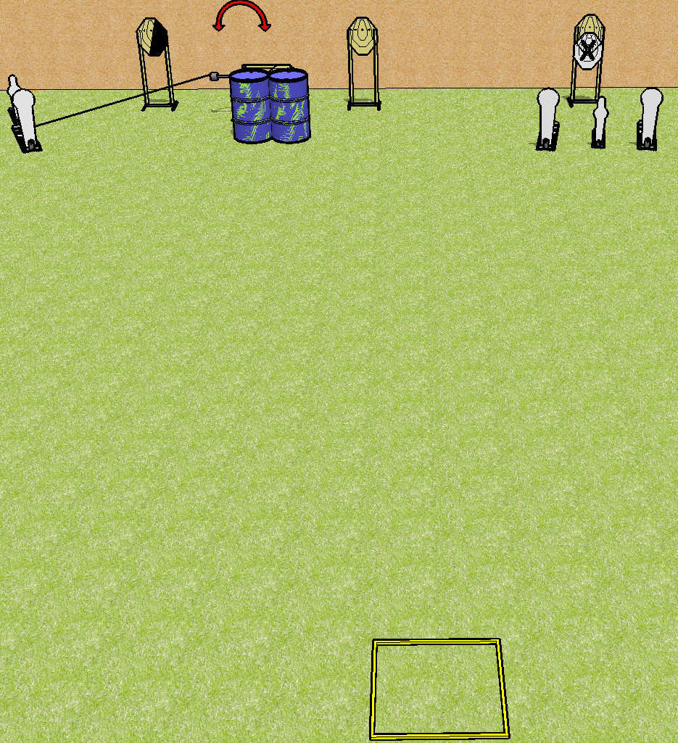
 | Dothan Practical Shooters – USPSA Match Rhythm Reload Course Designer : Drew Coleman Bay: B4
Round Count 13 rounds 4 IPSC 3 colt poppers, 2 mini poppers
Equipment List Shooting box Swinger + activator 1 right diag 4 targets (3 + 1NS)

Slide 2
Rhythm Reload
Written Stage Briefing
Scoring: Comstock Rounds: 13
Targets: 4 IPSC, 5 steel
Handgun start position: inside the shooting area, wrists below belt. Handgun is loaded and holstered.
PCC start position: inside the shooting area, stock on belt. Loaded carbine is held with both hands, safety on.
Stage Procedure: on the audible start signal, engage either array, perform a mandatory reload, then engage the remaining array STRONG HAND ONLY. Array 1 is P1, P2, T1, T2, and T3 (left side of stage). Array 2 is T4, P3, P4, and P5 (right side of stage).

